Slide 1

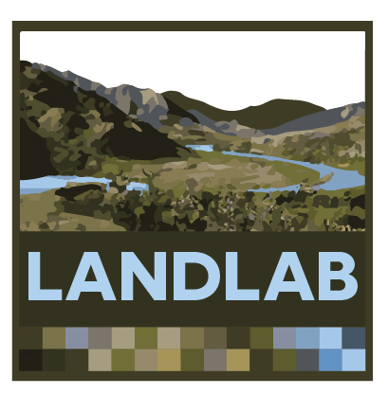

Modeling Earth Surface Dynamics with Landlab
Nicole Gasparini (She/Her), Tulane University
Huge thanks to Katy Barnhart, CU Boulder and Mark Piper, CSDMS

Slide 2
Material in this presentation comes from the Landlab team (in no particular order):
Tulane Team : Jordan Adams(*) & Nathan Lyons#
University of Colorado Boulder : Greg Tucker, Eric Hutton, Katy Barnhart#, & Margaux Mouchene (^{#)}
University of Washington : Erkan Istanbulluoglu, Sai Nudurupati*, and Christina Bandaragoda
Cardiff : Dan Hobley(#)

Slide 3
Goals for this class:
You will have a better idea of what Landlab is and what it can do.
You will know where to look to get help if you want to do more with Landlab.
You will play with some Landlab coupled models.

Slide 4
Assumptions I make in every class I teach:
If you have a question you will ask it.
If you are uncomfortable you will tell me.
If I ask you a question, you will try to answer, but if you cannot, it is fine to say “I pass”.
You will treat me and your classmates with respect. We are all working towards the same goal of learning about modeling with Landlab. Leave bias outside the classroom to the best of your ability.
Similarly,
I will do my best to answer your questions.
I will treat you with respect and without bias to the best of my ability.

Slide 5
Overview for clinic:
Introduction to Landlab, http://landlab.github.io/#/
Other important websites coming.
Running Landlab on CSDMS JupyterHub

Slide 6
Lots of modeling approaches out there...
CATCHMENT HYDROLOGY
(Ivanov et al., 2004)
SOIL EROSION
(Mitas and Mitasova, 1998)
GLACIER DYNAMICS
(Kessler et al., 2006)
Challenges with many academic models:
built to answer a specific research question and not easily adaptable.
poorly documented.
not tested.
platform dependent.
not open source.
DO WE REALLY NEED ANOTHER MODEL???
LANDSCAPE EVOLUTION
(Tucker and Hancock, 2010)
IMPACT CRATERING AND DEGRADATION
(Howard, 2007)
LAVA FLOWS
(Kelfoun et al., 2009)

Slide 7
What is Landlab?
A toolkit for building models of processes that happen on the earth surface – e.g. overland flow, bedrock river incision, growth and death of vegetation.
Not a landscape evolution model (LEM), but you can build LEMs with Landlab if you want to.
Open source.
A Python library.
Anyone can contribute to the library (following some basic rules).
Continuously tested.

Slide 8
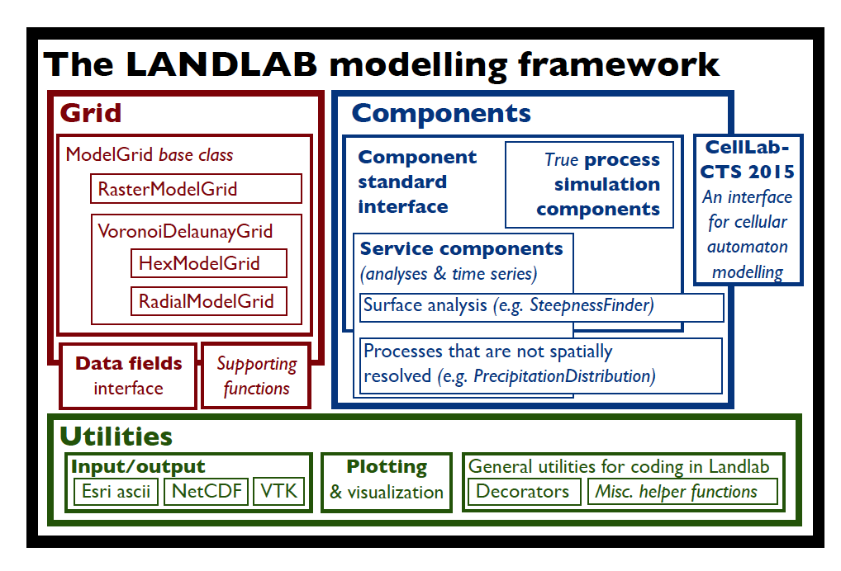
What is Landlab?
(Hobley et al., 2017, ESURF)

Slide 9
Landlab is also:
Extensively documented.
Has supporting materials such as:
Tutorials for learning Landlab.
Teaching materials for learning concepts in geomorphology and hydrology.
An issues page where you can search for answers and post questions.
A community of users, including YOU.

Slide 10
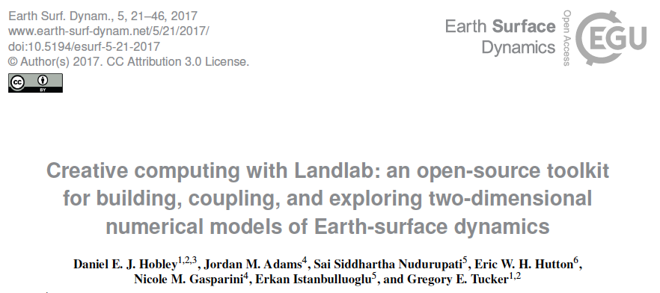
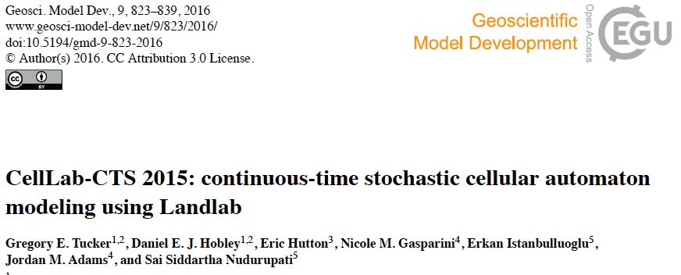
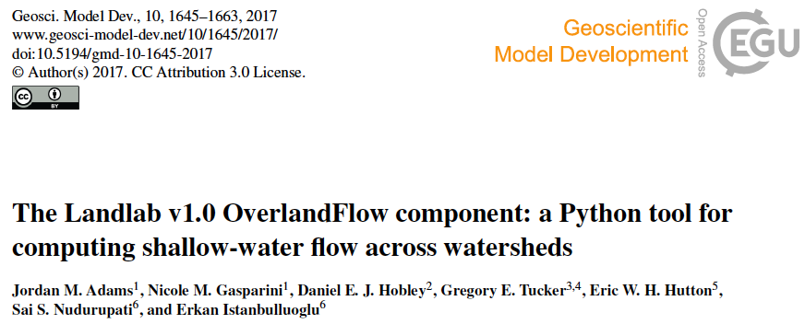
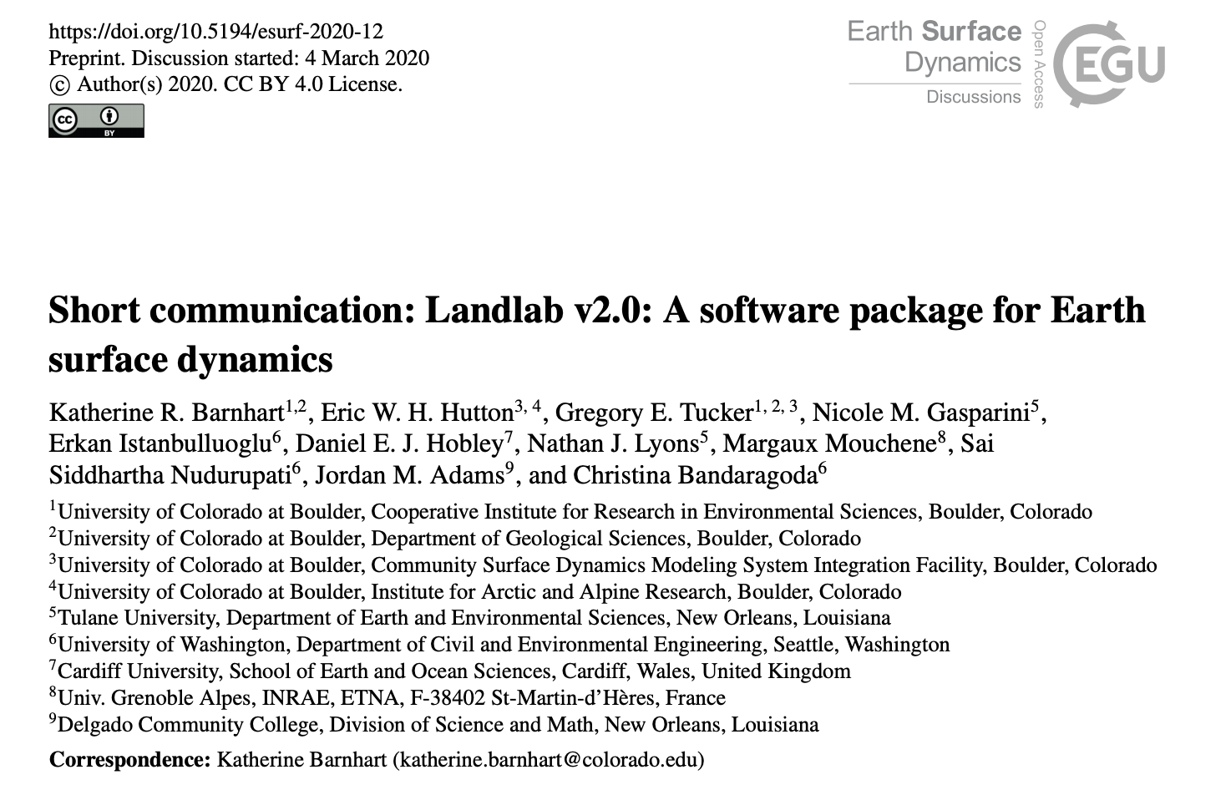
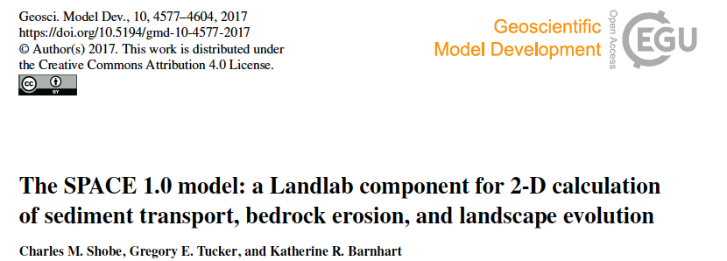
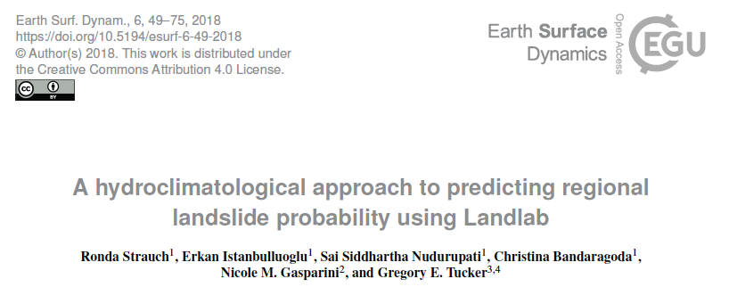
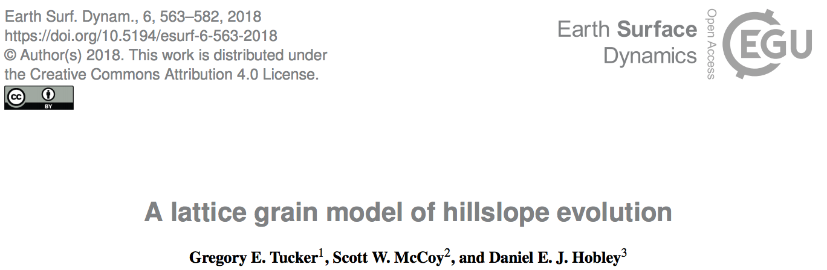

Slide 11
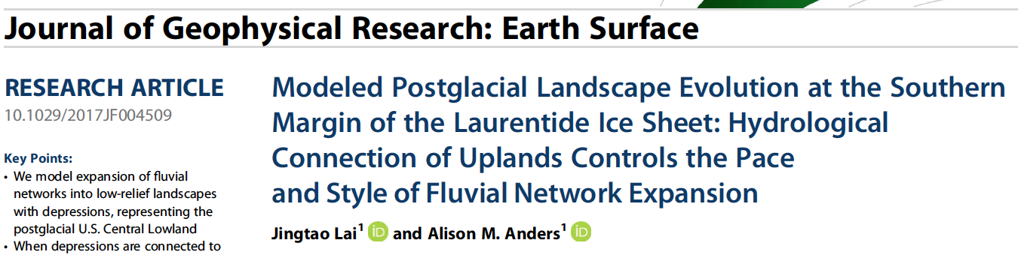
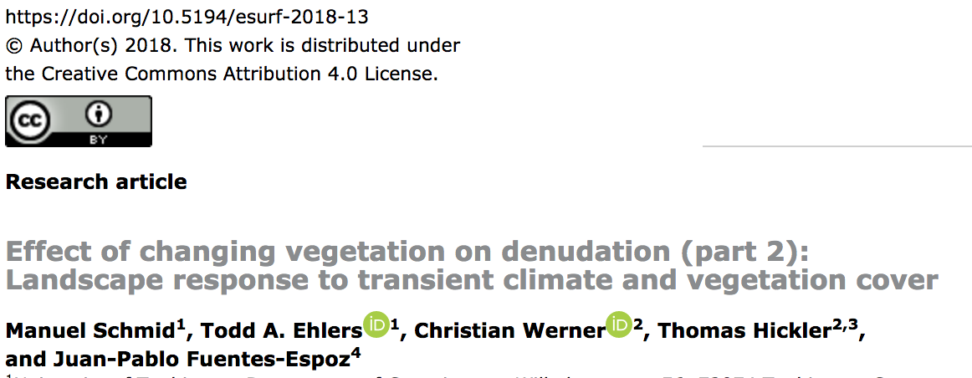

Slide 12
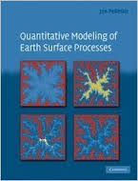
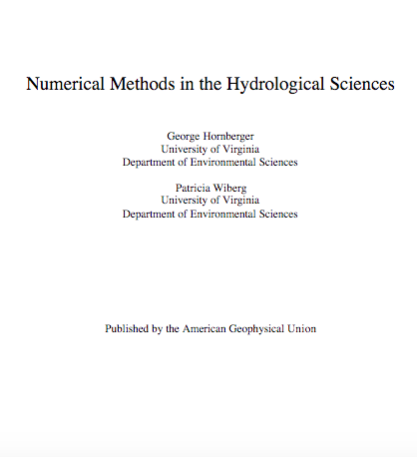
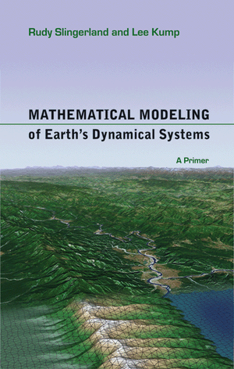
Why build numerical models?
What are numerical models?
SOFTWARE
NUMERICAL ALGORITHM
DYNAMICAL MODEL
NATURE

Slide 13
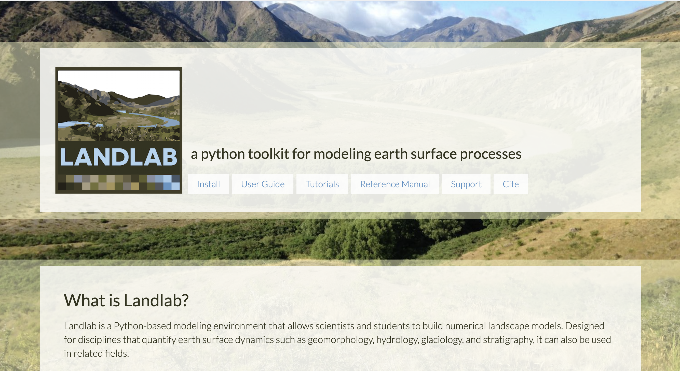
landlab.github.io

Slide 14
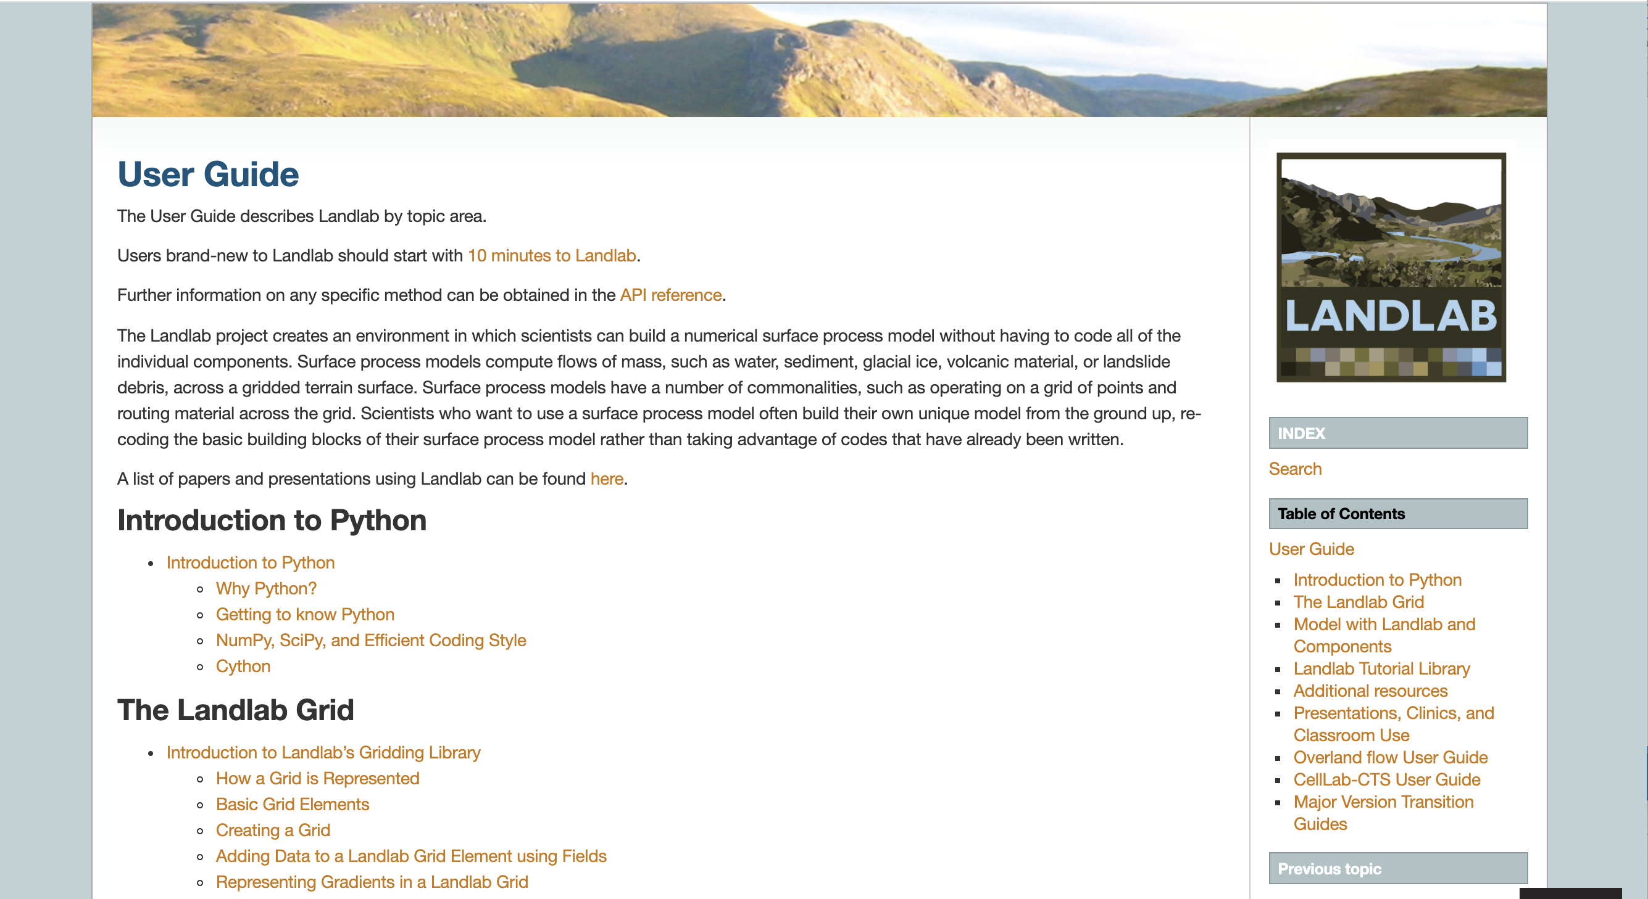
https://landlab.readthedocs.io/en/latest/user_guide/index.html

Slide 15
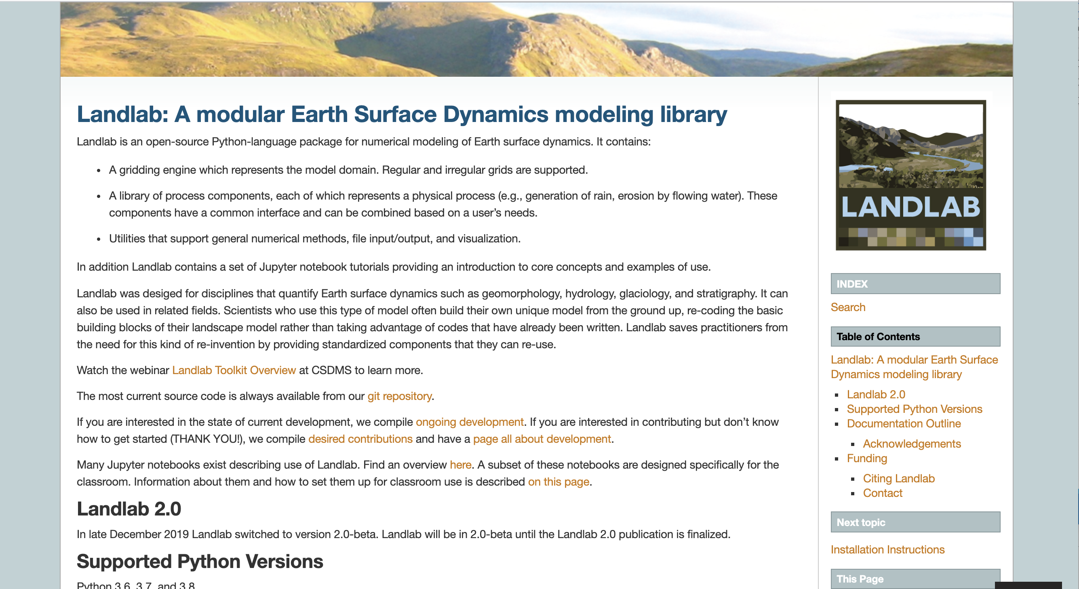
https://landlab.readthedocs.io/en/latest/ (Reference Manual)

Slide 16
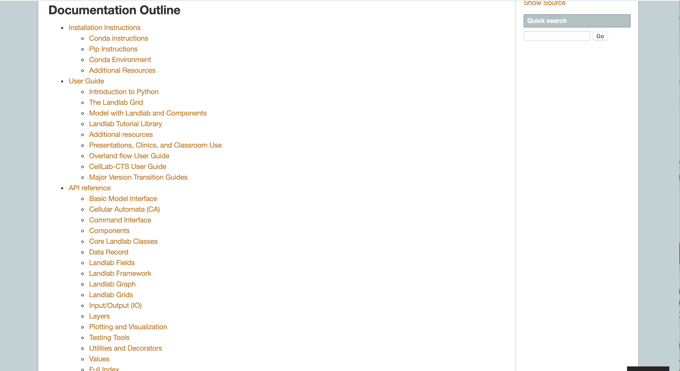

Slide 17
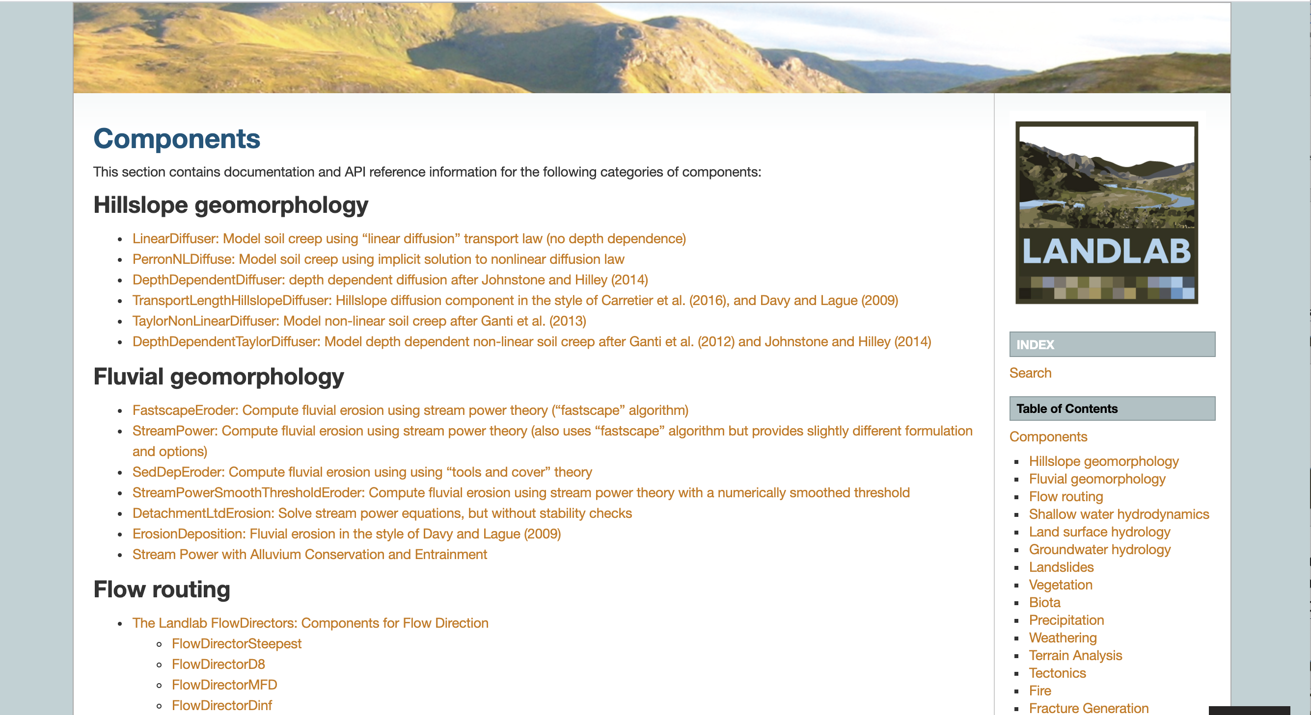

Slide 18
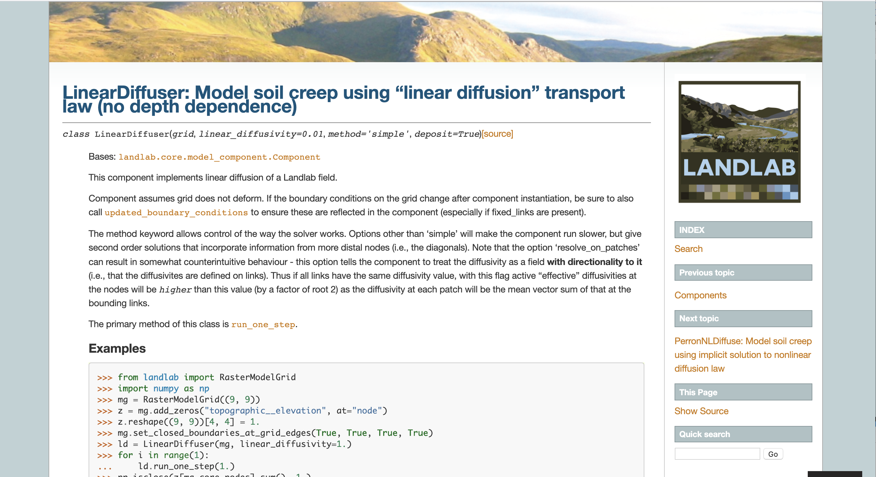

Slide 19
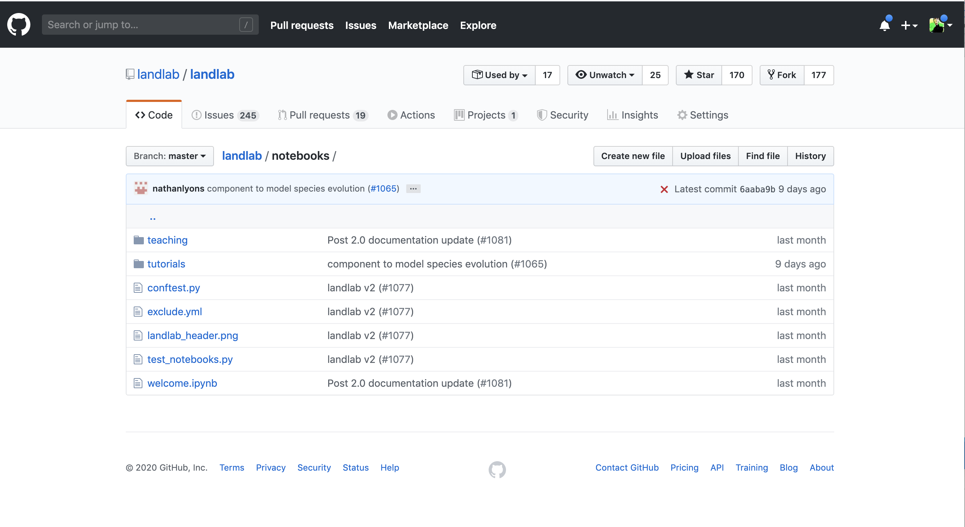
https://github.com/landlab/landlab/tree/master/notebooks

Slide 20
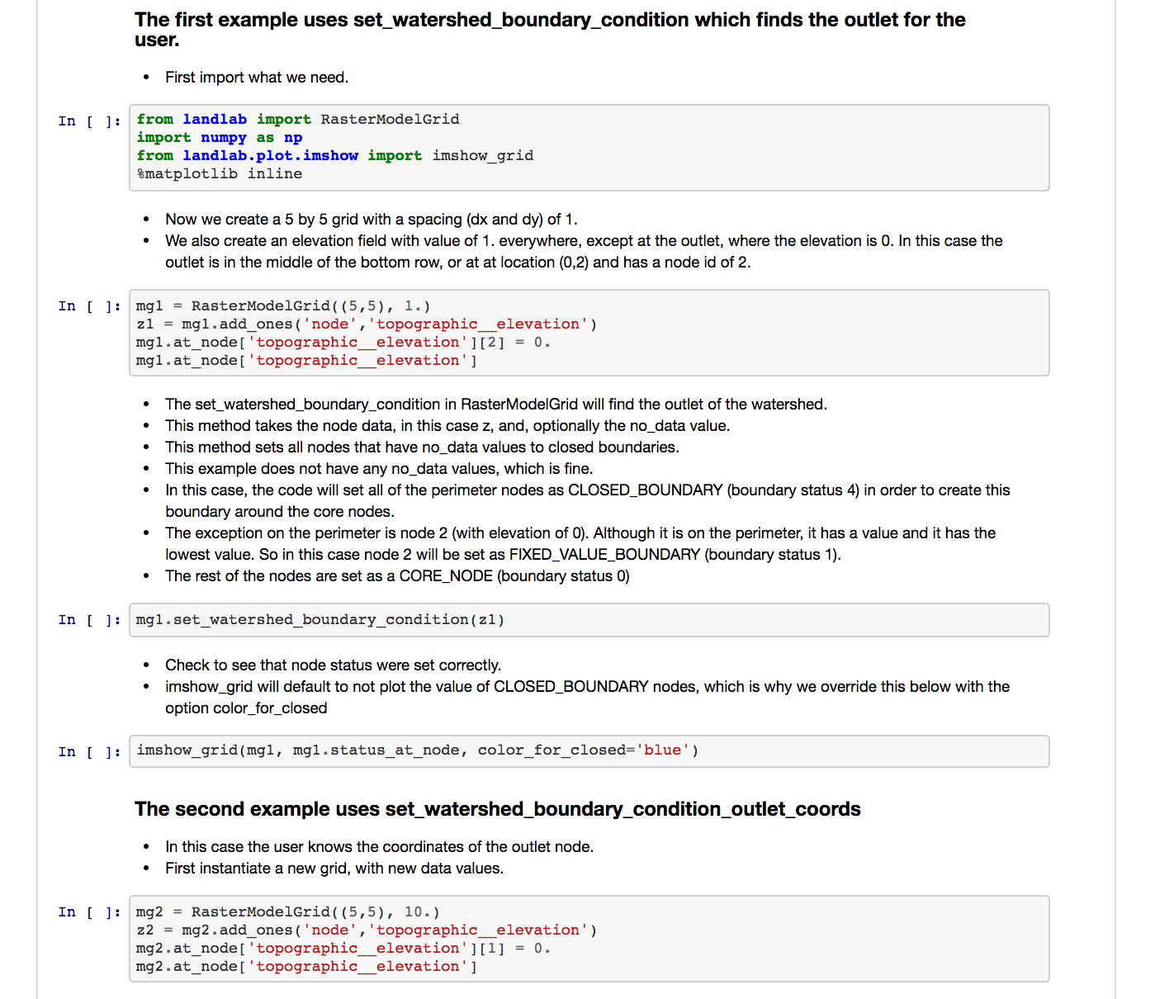

Slide 21
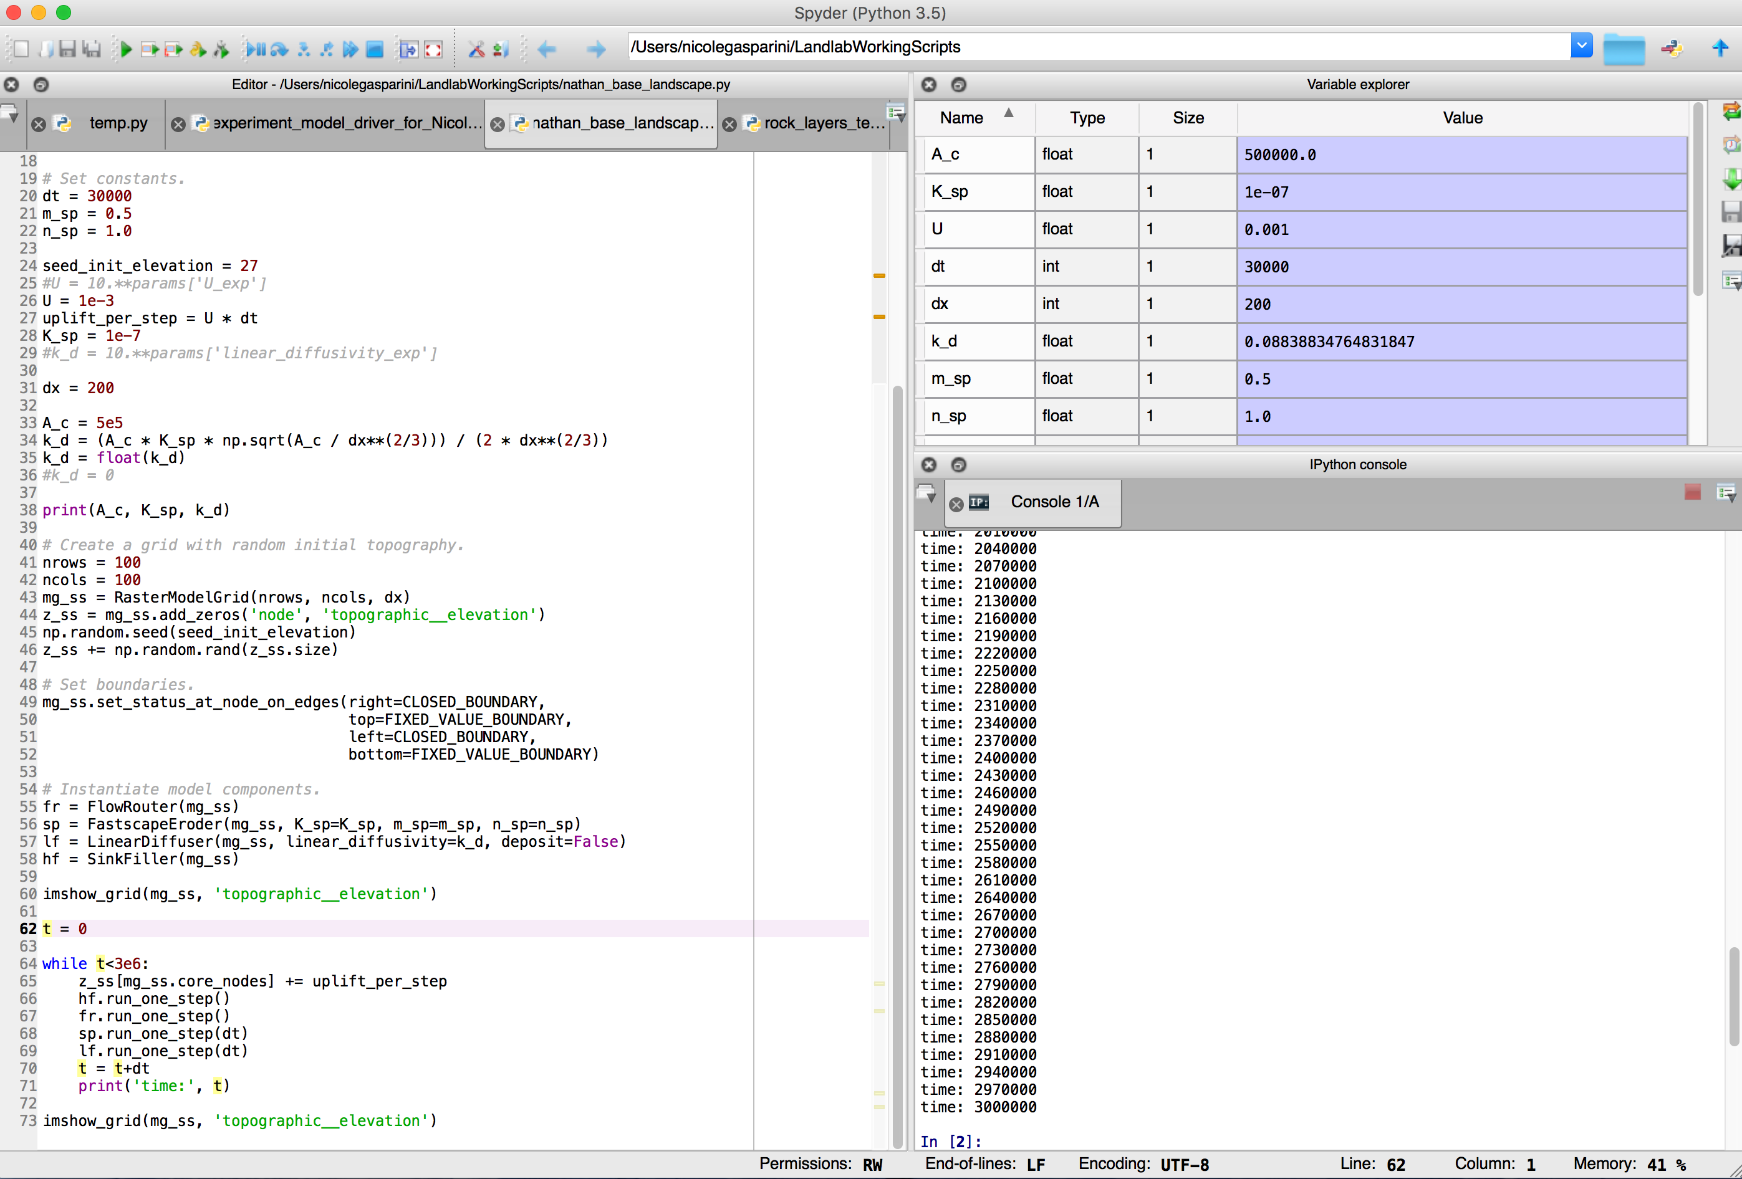

Slide 22
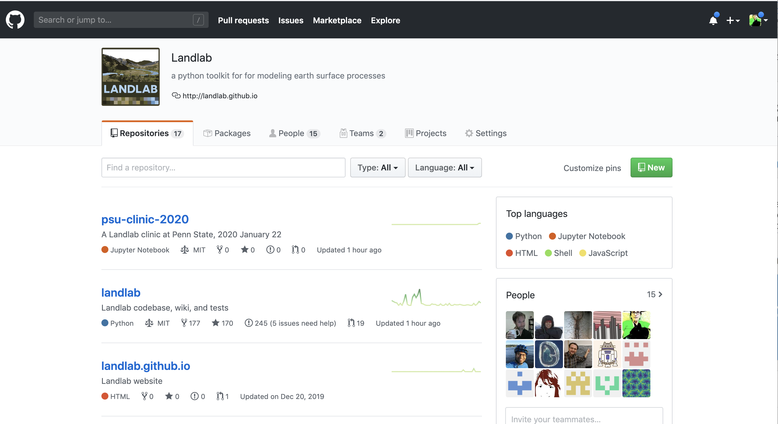
https://github.com/landlab

Slide 23
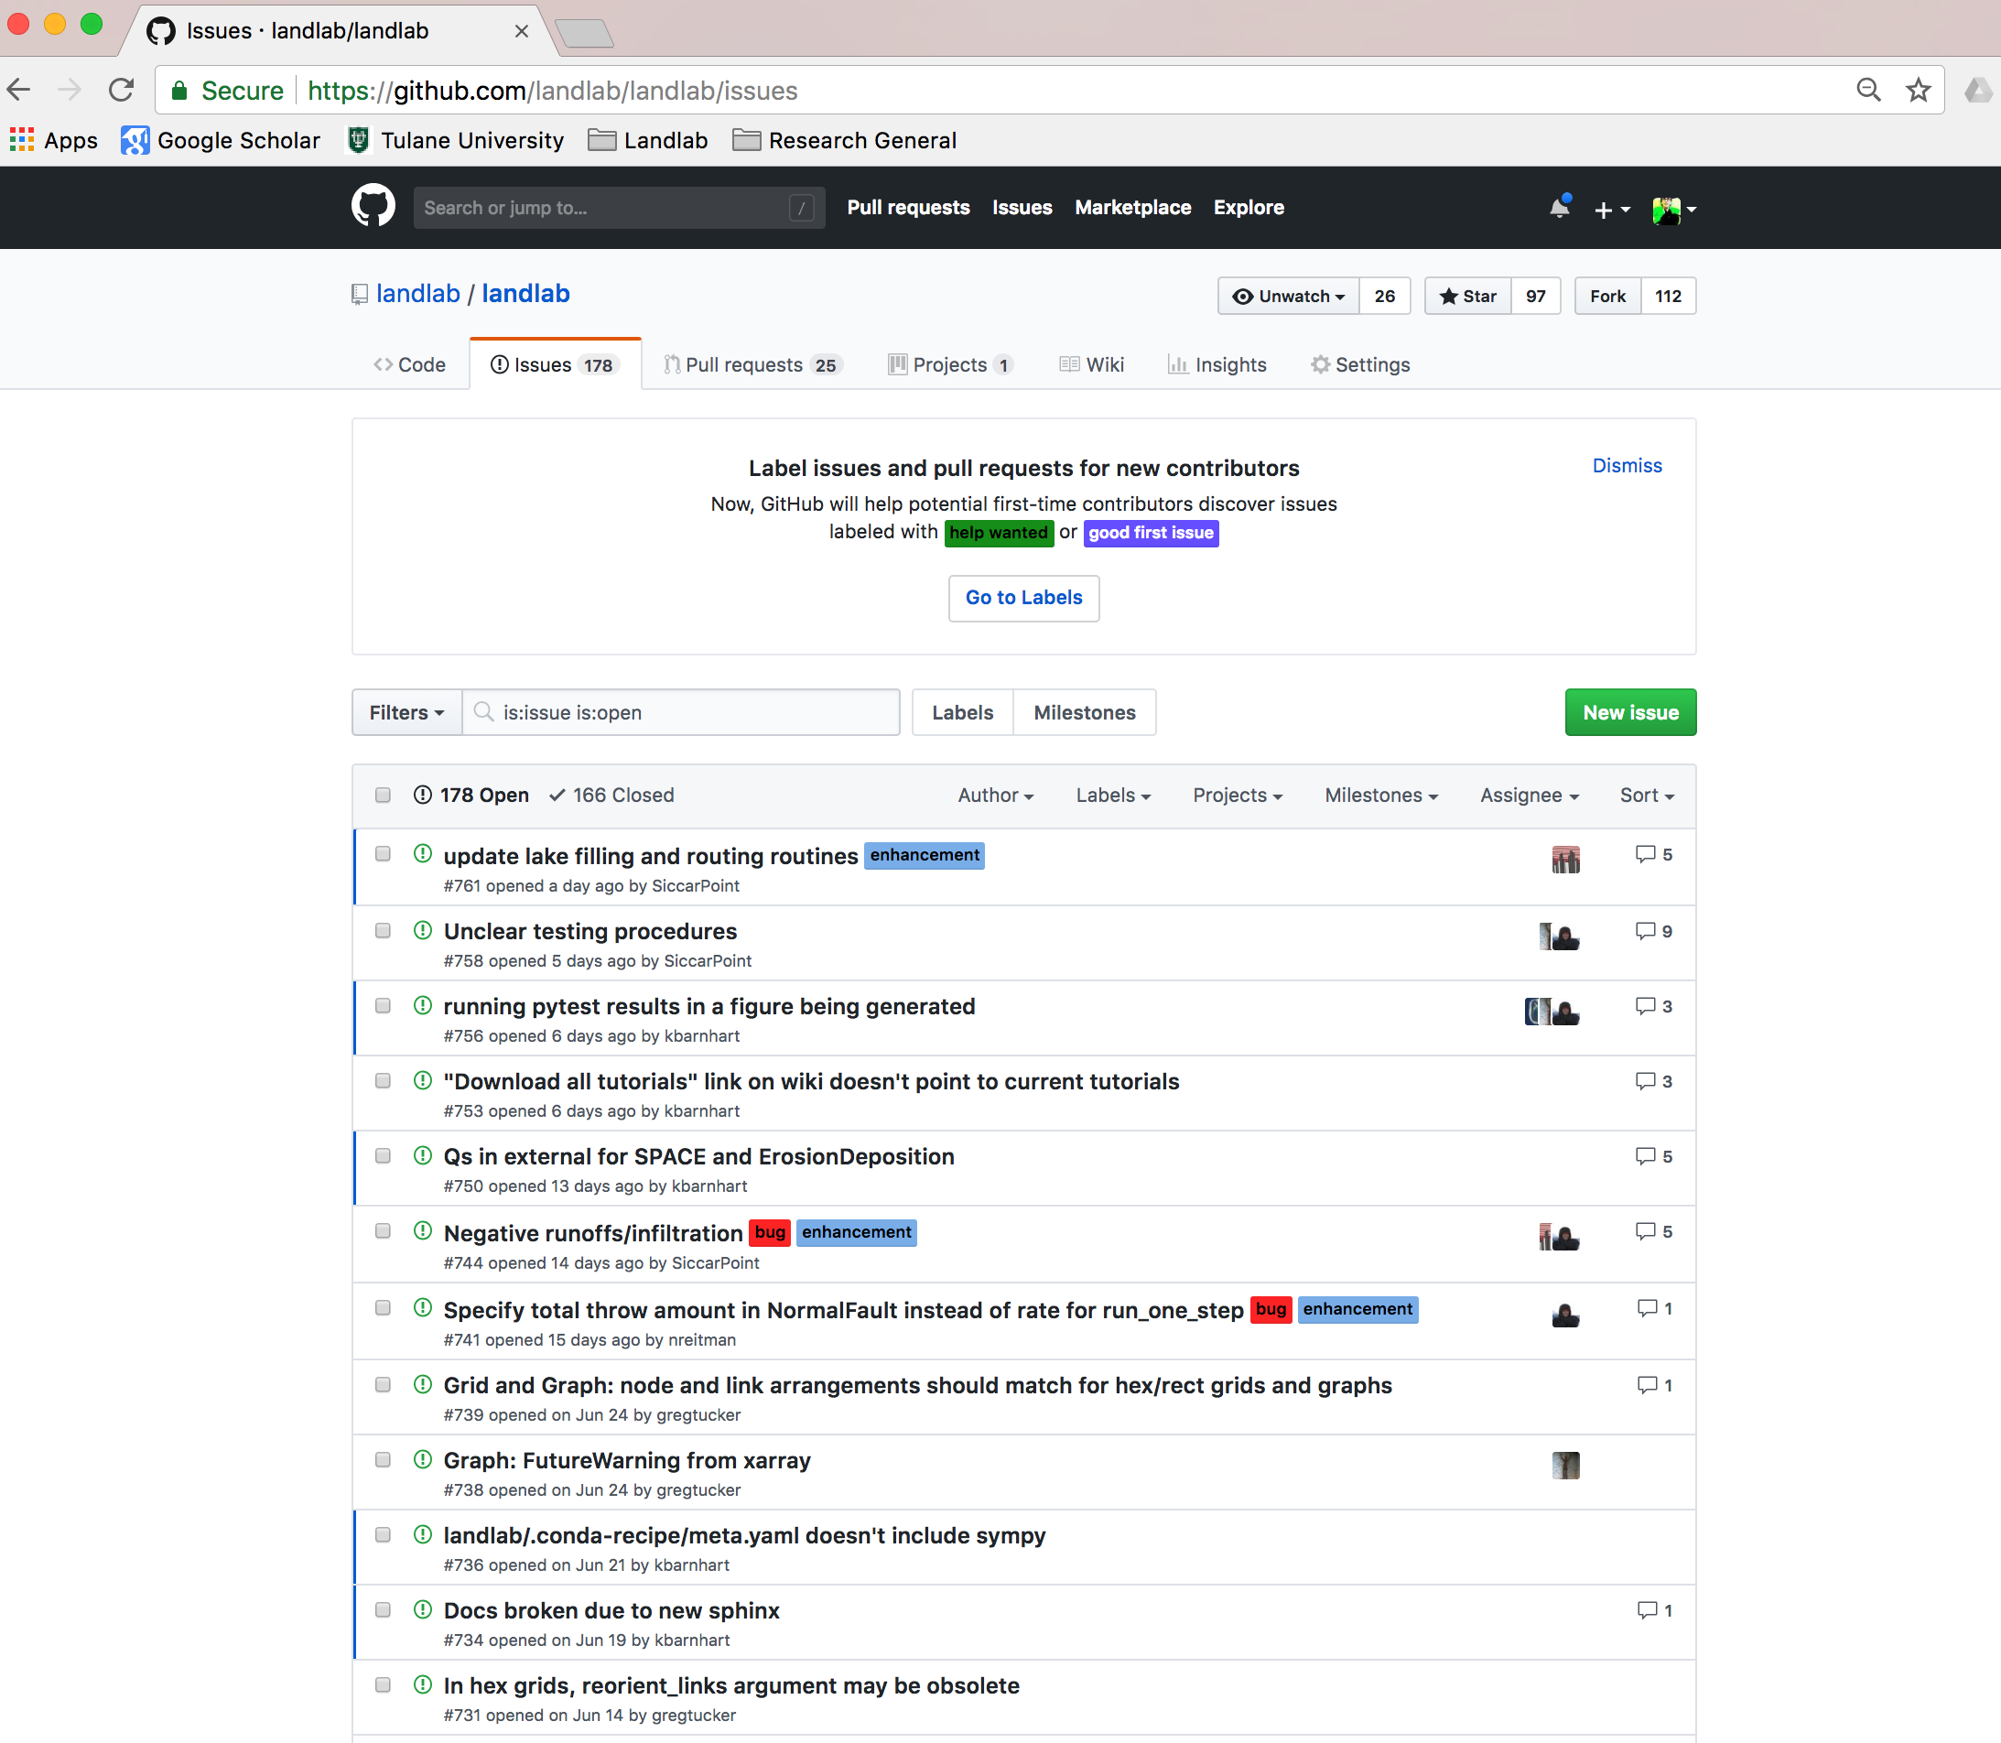
https://github.com/landlab/landlab/issues

Slide 24
Your average undergrad knows nothing about Landlab and numerical modeling.
Maybe even nothing about coding.
Step in their shoes!
They can still learn from models.

Slide 25
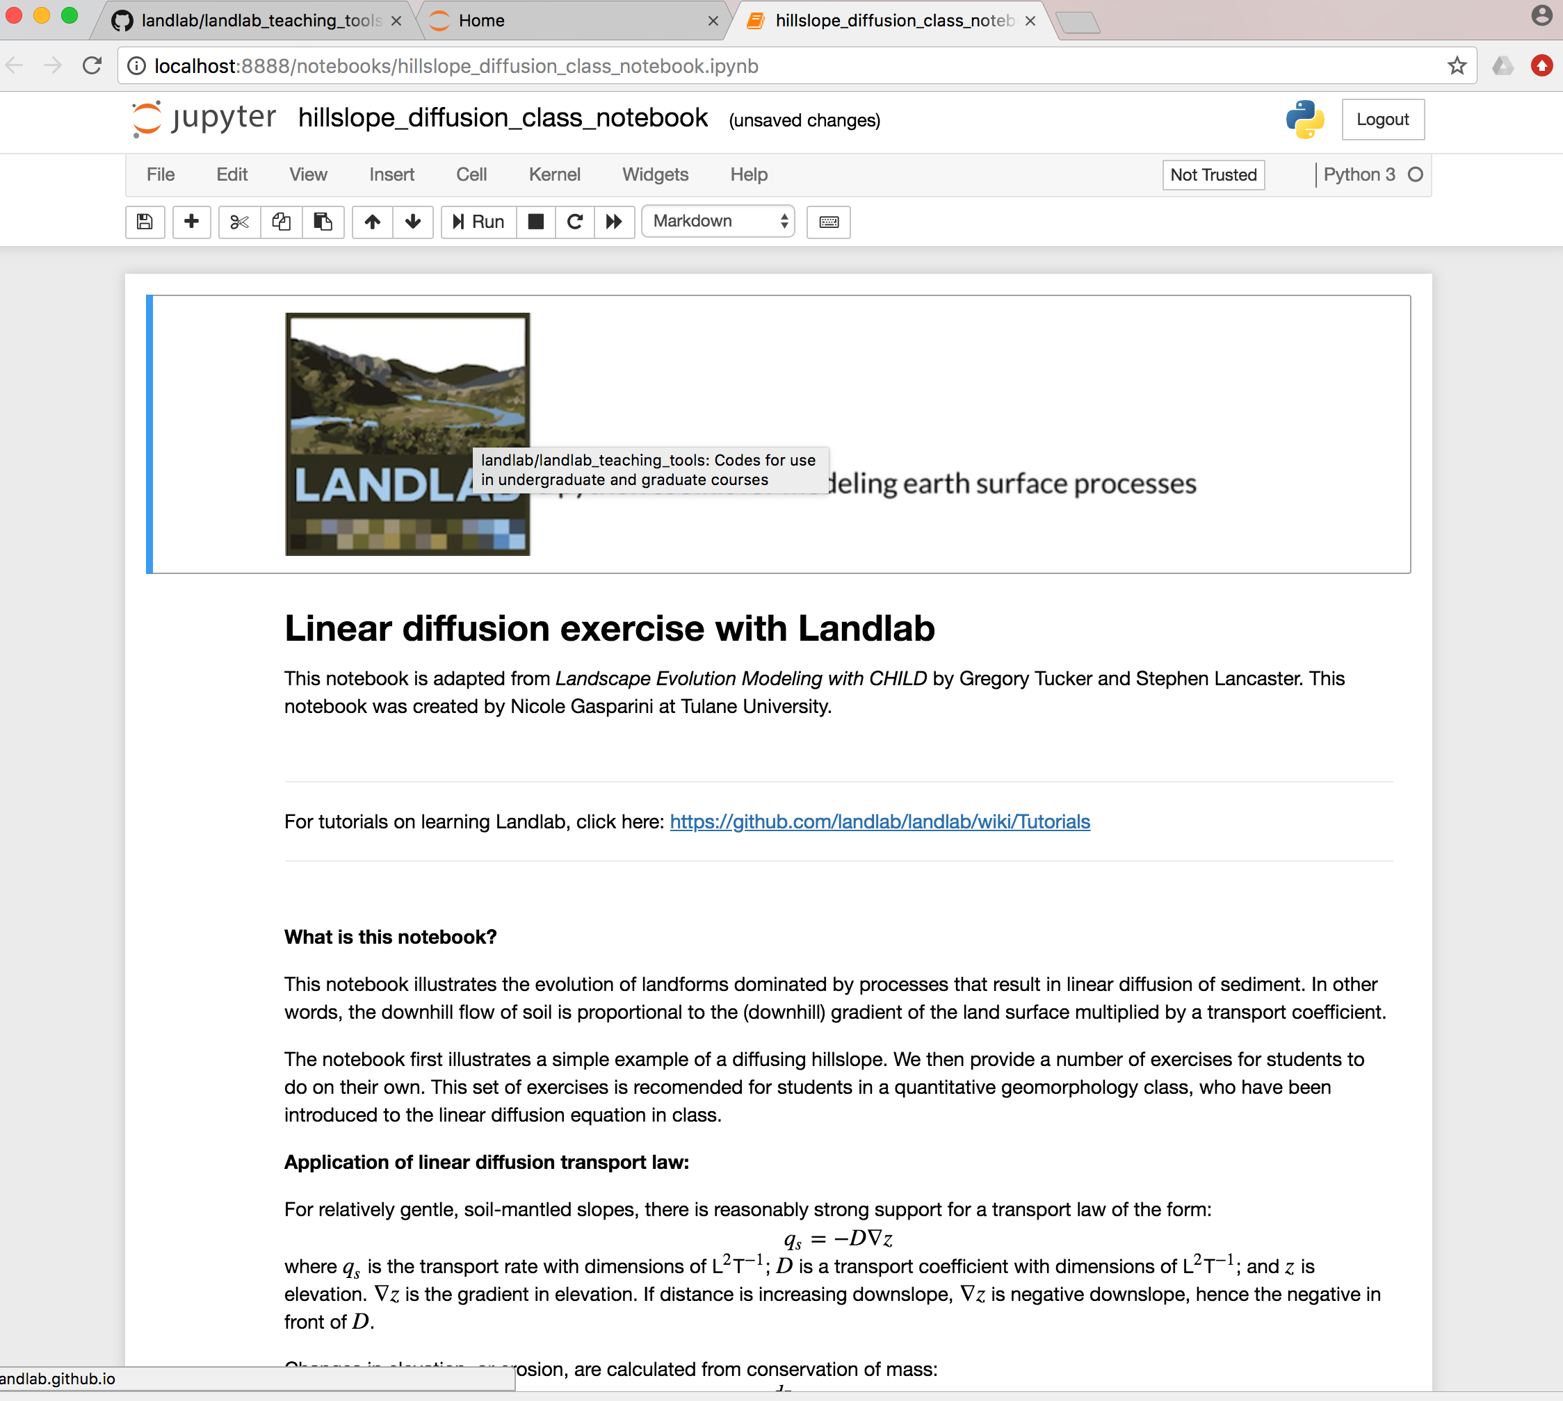

Slide 26
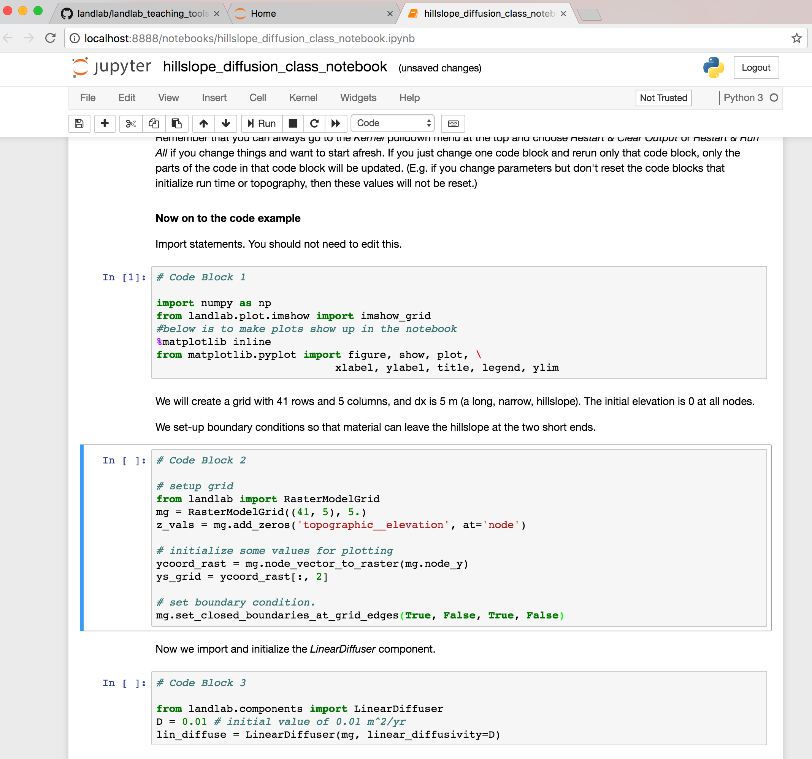

Slide 27
Take ~10 minutes to play with this notebook.

Slide 28
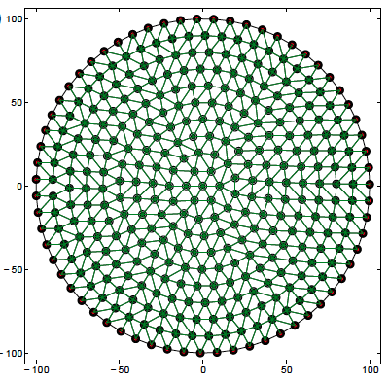
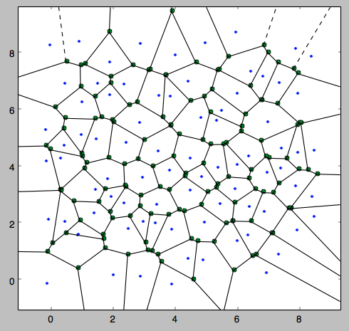
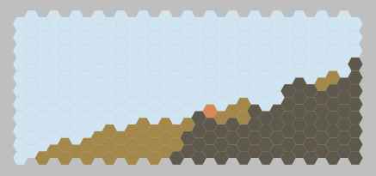
What Landlab provides
Grid creation and management
Create a structured or unstructured grid in one or a few lines of code
Attach data to grid elements
Facilitates staggered-grid schemes
Passing the grid = passing the data
VORONOI / DELAUNAY
RASTER
RADIAL
HEXAGONAL

Slide 29
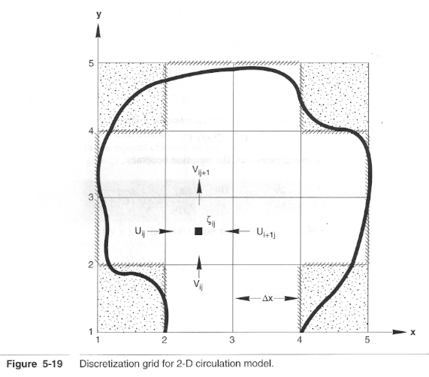
Using Landlab grids
Aim: make it easier to set up a 2D numerical model grid
Grid data and functions contained in a single Python object
Slingerland, Harbaugh, and Furlong (1994)

Slide 30
Quick side bar on Object Oriented Programing:
From Wikipedia: “Object-oriented programming (OOP) is a programming paradigm based on the concept of "objects", which may contain data, ... often known as attributes; and code, in the form of procedures, often known as methods. ” (https://en.wikipedia.org/wiki/Object-oriented_programming)
https://en.wikibooks.org/wiki/A-level_Computing/AQA/Paper_1/Fundamentals_of_programming/Elements_of_Object-Oriented_Programming

Slide 31
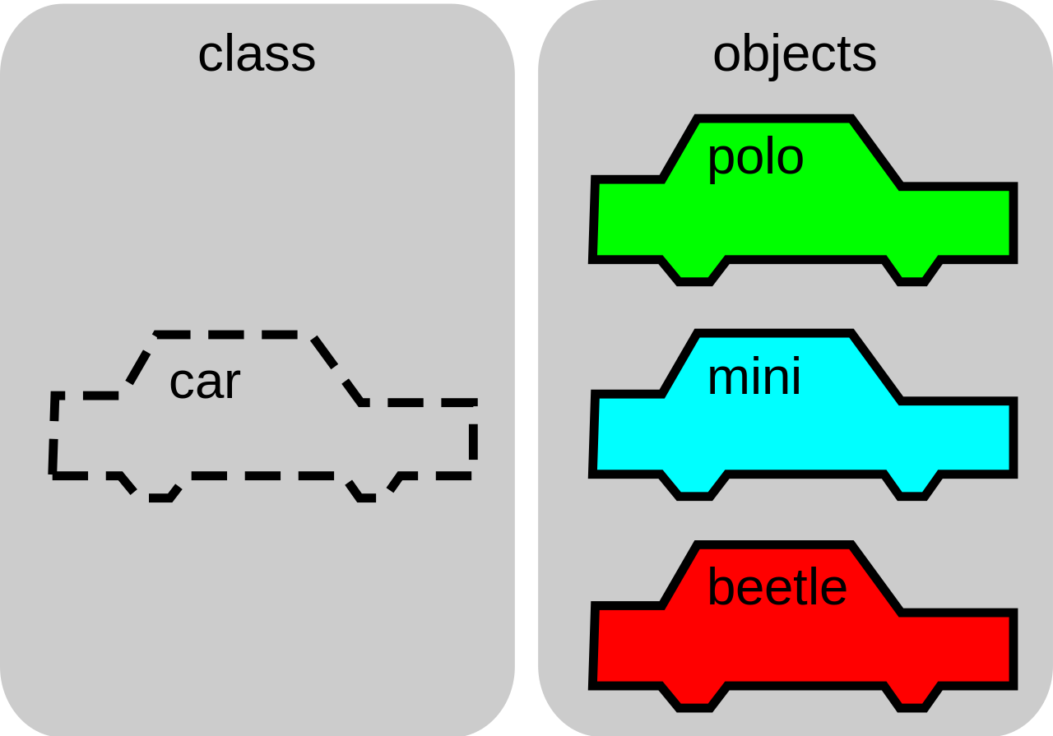
https://brilliant.org/wiki/classes-oop/

Slide 32
https://en.wikibooks.org/wiki/A-level_Computing/AQA/Paper_1/Fundamentals_of_programming/Elements_of_Object-Oriented_Programming

Slide 33
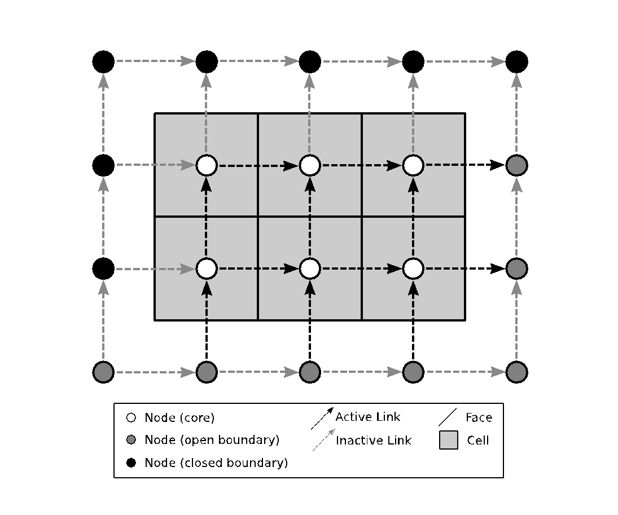
RasterModelGrid
Close B
Boundary nodes
Core nodes
Link = directed line segment connecting two adjacent nodes
Link direction is toward upper right half-space by default
(+)
Links
Close B
inactive
active
(+)
(+)
Tail node
Head node
Open B
CORE_NODE: 0; FIXED_VALUE_BOUNDARY: 1 (e.g. outlet)
TRACKS_CELL_BOUNDARY: 3 (looped boundary); CLOSED_BOUNDARY: 4

Slide 34
RasterModelGrid example: Create a 4 by 5 grid
>> from landlab import RasterModelGrid
>> rg = RasterModelGrid((4,5),10.0)
>> rg.number_of_nodes
Out: 20
>> rg.number_of_links
Out: 31
>> rg.number_of_node_rows
Out: 4
>> rg.number_of_node_columns
Out: 5
>> rg.number_of_core_nodes
Out: 6
>> rg.number_of_cells
Out: 6
Notes:
RasterModelGrid is class. The Landlab team created it. That class includes attributes (data) and methods (functions).
Rg is an object of type RasterModelGrid (that line is ”instantiating” an object.
Have students open up spyder here. Show them the “?”

Slide 35
Fields: Attaching data to the grid
A field is a NumPy array containing data that are associated with a particular type of grid element (typically nodes or links)
Fields are 1D arrays
Values correspond to the element with the same ID. Example: value 5 of a node field belongs to node #5.
Fields are “attached” to the grid (the grid object includes dictionaries listing all the fields)
Fields have names (as strings)
Create fields with grid functions add_zeros, add_ones, or add_empty

Slide 36
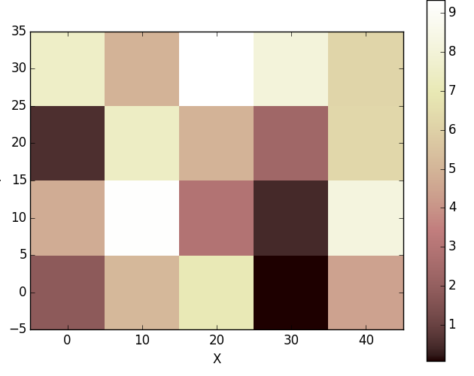
Example: attaching data to the grid
>> from landlab import RasterModelGrid
>> rg = RasterModelGrid((4,5),10.0)
Create a random field and “attach” it to the grid as ‘elevation’
>> import numpy as np
>> z=10*np.random.rand(rg.number_of_nodes)
>> rg.add_field('node’,’topographic__elevation’, z)
Plot the elevation field
>> from landlab.plot import imshow_grid
>> import matplotlib.pyplot as plt
>> imshow_grid(rg, ’topographic__elevation')
>> plt.show()
>> rg.at_node.keys()
Notes:
Make sure to show them the ‘click’ function.

Slide 37
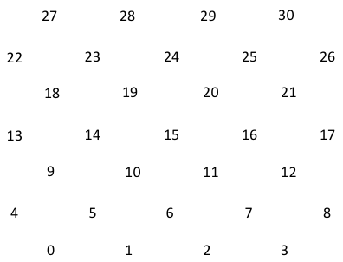
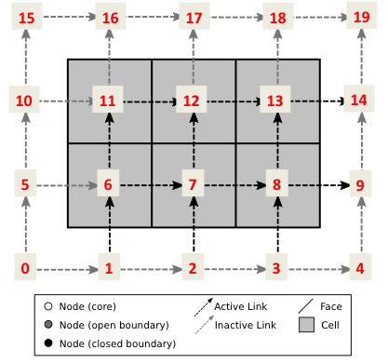
Explore node and link structure and “attached” data
Starting from the Southwest corner nodes are numbered to the East in each row. Links are numbered using the number of their tail nodes.
>> rg.status_at_node[13]
Out: 0
>> rg.links_at_node[13]
Out: array([21, 25, 20, 16])
>> rg.link_dirs_at_node[13]
Out: array([-1, -1, 1, 1])
>> rg.node_at_link_tail[20]
Out: 12
>> rg.node_at_link_head[20]
Out: 13
>> rg.at_node[’topographic__elevation'][13]
Out: 2.36
Now set ‘elevation’ to 100
>> rg.at_node[' ’topographic__elevation’][13]=100
OR: z[13]=100
>> rg.at_node[' ’topographic__elevation '][13]
Out: 100
CORE_NODE: 0; FIXED_VALUE_BOUNDARY: 1 (e.g. outlet)
TRACKS_CELL_BOUNDARY: 3 (looped boundary); CLOSED_BOUNDARY: 4

Slide 38
What Landlab provides
2. Components and coupling framework for components
A component models a single process (e.g., lithosphere flexure, linear diffusion, flow routing across terrain)
Components have a standard interface and can be combined by writing a short Python script (model, driver)
Initialized using input grid and parameters
Update relevant ‘fields’ on the grid
Components also include analytical tools for analyzing landscapes (e.g. channel steepness, hillslope length, …)
Most components have a method “run_one_step” carries out the process.

Slide 40
What Landlab provides
3. Input, output, visualization
Read model parameters from a formatted text file (optional)
Read in digital terrain data (e.g., DEMs) ➔ grid
Write gridded output to files (netCDF format)
Plot data using Matplotlib graphics library

Slide 41
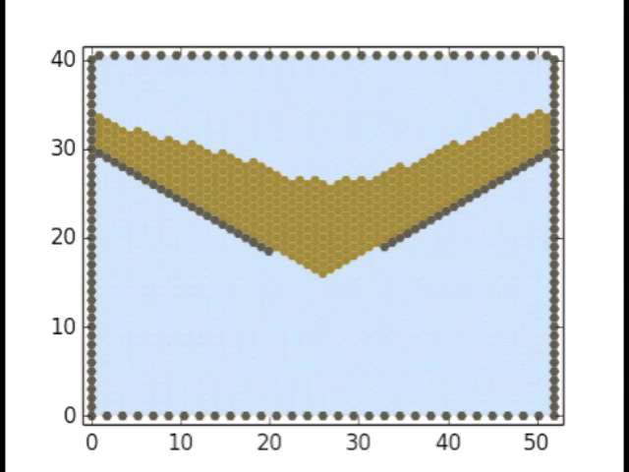
What Landlab provides
4. Support for cellular-automaton modeling
CellLab-CTS: Continuous-time stochastic CA model “engine”
(Tucker et al., 2016 Geoscientific Model Development)

Slide 42
How do you create a Landlab model?
Your unique creation.
Usually a model will:
Operate on a grid;
Create data;
Use components to update data values through time;
Visualize data.
but it does not have to do all of these things.
Notes:
Most operations that we think of operate on a grid, and most components require a grid. However there are a few exceptions, such as the uniform rainfall generator component, which creates a time series so does not need a grid. Similarly, you can imagine cases in which you might not update values through time … we will see an example of this with the ecohydrology model, in which we calculate radiation, PET, and soil moisture all at a given time. Similarly, one might want to create data but visualize them outside of Landlab, say netCDF data visualized with paraview.

Slide 43
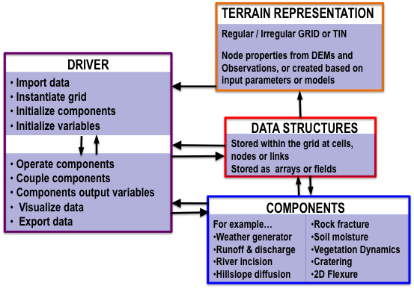

Slide 44
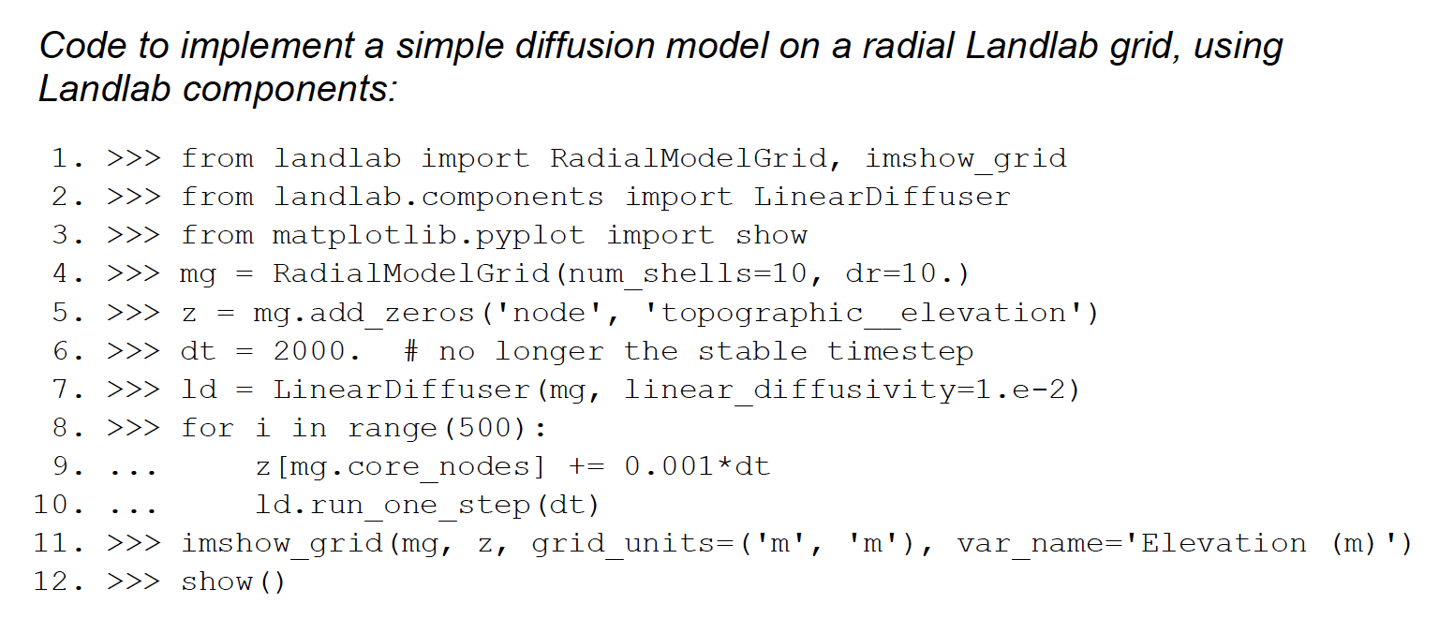
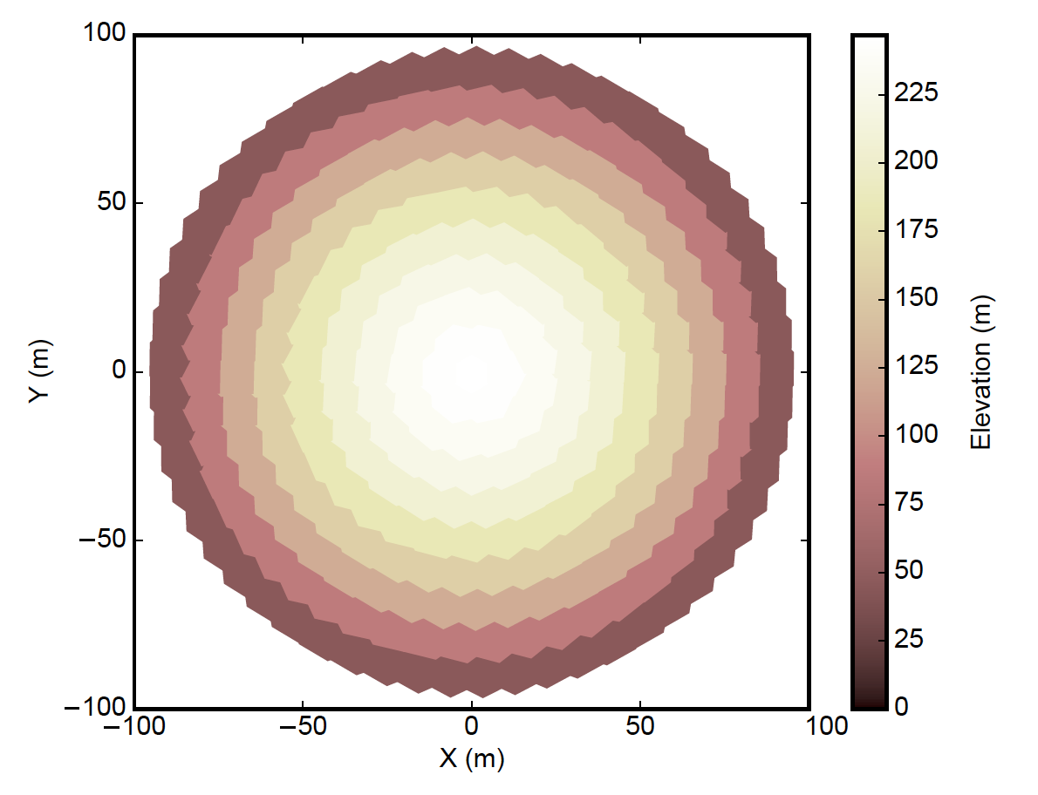
Example single component diffusion model
(Hobley et al., 2017, ESURF)

Slide 45


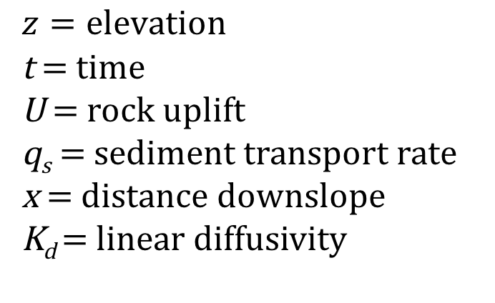

Linear Diffusion Equation
$$q_{s}=−K_{d}∇z$$
$$z=elevation$$
t = time
U = rock uplift
q_{s} = sediment transport rate
x = distance downslope
K_{d} = linear diffusivity
$$q_{s}=−K_{d}\frac{dz}{dx}$$
$$\frac{dz}{dt}=U−\frac{dq_{s}}{dx}$$

Slide 46
Single component diffusion model
Import Statements
(Hobley et al., 2017, ESURF)

Slide 47
Single component diffusion model
Instantiate model grid; Add data/create field
(Hobley et al., 2017, ESURF)

Slide 48
Single component diffusion model
Initialize parameter;
Instantiate diffusion object
(Hobley et al., 2017, ESURF)

Slide 49
Single component diffusion model
Time loop;
Do the calculations!
(Hobley et al., 2017, ESURF)

Slide 50
Single component diffusion model
Visualize data
(Hobley et al., 2017, ESURF)

Slide 51
Every model is some variant of the previous example
Can be on the command line (as last example).
Can be a Python (.py) file that is run from the command line.
Can be an Jupyter Notebook (.ipynb), which is great for teaching and learning.

Slide 52
Run some more models on CSDMS JypterHub
Overland Flow
Simple Landscape Evolution Model
Landscape and life evolution

